Slide 1
Securing data hiding in images using steganogrpahy
CAPSTONE PROJECT
Presented By: MOHD TAUSEEF ALI
Student Name : MOHD TAUSEEF ALI
College Name & Department : MJCET

Slide 2
OUTLINE
Problem Statement
Technology used
Wow factor
End users
Result
Conclusion
Git-hub Link
Future scope

Slide 3
Problem Statement
Enhancing Data Security Through Steganographic Techniques
Improved Steganographic Algorithms: Develop new or enhance existing steganographic algorithms to securely embed hidden messages in digital media files (images, audio, video).
Data Integrity and Detection Resistance: Focus on increasing the robustness of hidden data against detection by attackers or unauthorized parties, even in the presence of common attacks such as compression, resizing, or format changes.
Capacity Optimization: Explore methods to maximize the amount of data that can be hidden without significantly degrading the quality or integrity of the host media file.
Security Features: Investigate encryption mechanisms integrated with steganography to ensure that even if the hidden data is extracted, it remains unreadable without the proper decryption key.

Slide 4
Technology used
Windows 10,
With Intel i5 3rd Gen Processor, 500GB HDD, 8GB RAM
Python,
Open CV,
String,
Open OS

Slide 5
Wow factors
Visual Transformation
Advanced Algorithms
Enhanced Security
3D or Multidimensional Steganography
Steganography in Audio/Video
User Interface (UI) for Simplicity
Real-time Messaging with Animated Hidden Data

Slide 6
End users
Military
Navy
Health Organisation
Other Govt. Sector

Slide 7
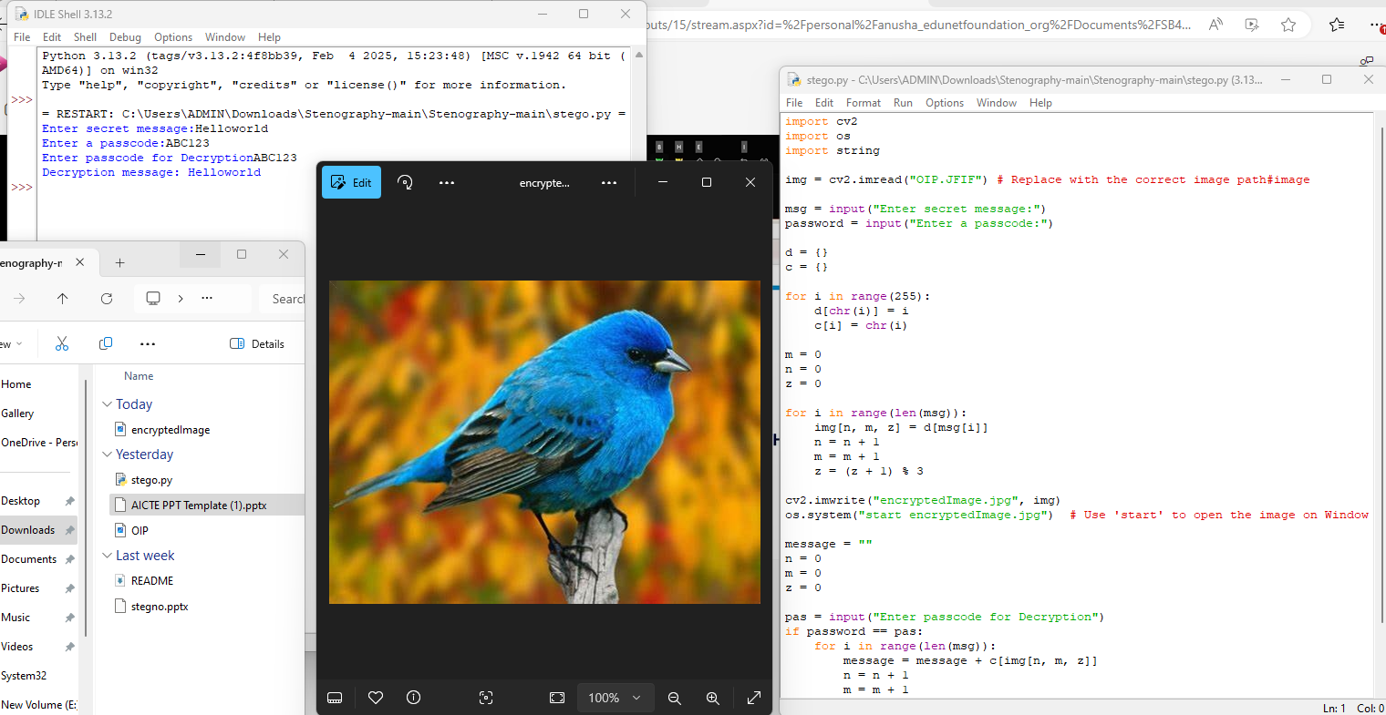
Results

Slide 8
Conclusion
Conclusion on Steganography:
Steganography is a powerful technique used to hide information within other forms of media, such as images, audio, or video, in a way that is not perceptible to the human eye or ear. It plays a crucial role in maintaining privacy, security, and confidential communication, especially in situations where traditional encryption might raise suspicion. By embedding hidden messages within seemingly innocent content, steganography allows for covert transmission of sensitive information without attracting attention.
Problem Statement:
As digital communication continues to evolve, the need for secure and discreet data transmission grows. However, with increasing advancements in steganalysis tools, detecting hidden information within digital media is becoming more sophisticated. This creates a pressing need for improved, robust steganographic techniques that can resist detection, support larger payloads, and provide greater security, while also being practical and efficient for everyday use. The challenge lies in striking a balance between hiding data and maintaining the integrity of the carrier media.

Slide 9
GitHub Link
tauseef201/IBM-Intership

Slide 10
Future scope(optional)
The future of steganography is poised to evolve significantly with advancements in technology. As digital communication continues to grow, steganography will likely see increased use in multimedia, such as audio, video, and even 3D content, offering new avenues for hidden data transmission. Machine learning and AI will play a crucial role in developing more advanced, undetectable techniques, improving both the robustness and capacity of data hiding.
Additionally, cloud storage and cross-platform communication will enable more secure and covert data sharing across devices and networks. Blockchain integration could also enhance the security and integrity of hidden data by ensuring immutability and decentralization.

Slide 11
THANK YOU

